Slide 1

Process Control Design of ITER Heat Rejection System
Hiren Patel
ITER-India, IPR
With Contributions from: A.G.A. Kumar¹, D.K. Gupta¹, N. Patel¹, J. Dangi¹, G. Gohil¹, L. Sharma¹, M. Jadhav¹, F. Somboli², S.Ployhar² and L. Teodoros²
¹ITER-India, Institute for Plasma Research, Gandhinagar
²ITER Organization, 13115 St Paul Lez Durance, France
The views and opinions expressed herein do not necessarily reflect those of the ITER Organization.

Slide 2
HRS Overview
Notes:
HRS stands for Heat Rejection System which is responsible to remove the entire heat load of ITER Tokamak & other Auxiliary systems, transported through intermediate close cooling loops, to atmosphere. HRS is so design that it can reject ~1200 MW of Intermittent heat load received during Plasma Burn period with the help of cooling tower of ~510 MW and a buffer basin. The heat load received during plasma dwell period is about 1/10th of that is during plasma burn. The Hot water at ~63 °C during plasma burn is mixed with the relatively cold water received during plasma dwell of previous plasma cycle in the hot basin. The water in the hot basin thus never cross 50 °C which is cooled in the cooling tower passing at a constant rate through it.

Slide 3
Presentation Outline
Design Inputs
Functional Analysis
I&C Functions
Control System Architecture
Operation Management

Slide 4
Presentation Outline
Design Inputs
Functional Analysis
I&C Functions
Control System Architecture
Operation Management

Slide 5
Design Inputs
I&C Design
Process Requirements
Equipment Protection Requirements
Operational Requirements
Notes:
Design inputs are derived from the documents like SRD, PFD, P&ID etc. and are documented in DDD. The process requirements are derived from Functional analysis of the system. The Protection requirements are

Slide 6
Presentation Outline
Design Inputs
Functional Analysis
I&C Functions
Control System Architecture
Operation Management

Slide 7
Functional Analysis
Functional Analysis
  Structured top-down approach
  System Requirements converted to the Basic functions
  Basic Functions are broken down to micro functions
  Define Components & Utility to fulfil the requirements.
Micro functions are also analyzed to identify its control & monitoring requirements (termed as I&C functions).
The I&C functions are built considering
  Process Control logics
  Equipment Protection Logics
  Operating sequence
I&C functions forms modular bricks which can be enabled/disabled in sequence using a state machine to preform during prevailing operating scenario

Slide 8
HRS Functional Breakdown
Functions like Water Chemistry Control &

Slide 9
Heat Removal
The HRS pumps circulating water through CCWS – 1 PHEs, are equipped with Variable Frequency Drive (VFD)
The speed of each of these pumps is modulated according to the heat load of CCWS – 1 to keep its supply water temperature close to 31 °C.
In other words, during the burn time, pumps deliver rated flow while during dwell flow is reduced.
As the heat load is relatively constant in CCWS – 2 throughout the plasma cycle, a Flow Control Valve (FCV) is used on HRS header to control the flow through PHEs.
The valve regulates the flow as per the temperature variation on supply header of CCWS – 2 loops.

Slide 10
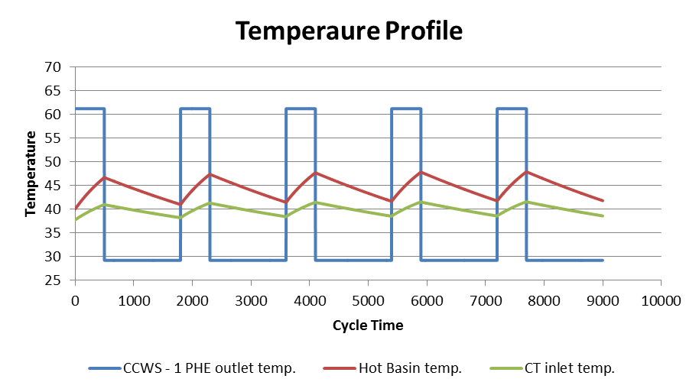
Heat Rejection
For effective heat rejection by CT, it is important to maintain the flow and inlet water temperature constant and close to design value of CT.
Since the hot water temperature from CCWS – 2 PHEs is relatively constant, it is carried to CT directly.
The hot water temperature from CCWS – 1 PHEs is still having pulsating behavior, though minimized a little by VFD action.

Slide 11
Heat Rejection
To make the temperature of the water more uniform, a hot basin is used as a buffer.
Hot water during burn and dwell are mixed in the hot basin and achieve average temperature & transferred to CT using another set of pumps.
The hot water from hot basin and that from CCWS – 2 PHEs are mixed in the header before passing through CT.
The heat load carried by the water is rejected in CT and the cold water at 27 °C from CT is collected in the cold basin below the CT.

Slide 12
Volume Control
The flow through CCWS – 1 PHEs varies largely (~60%) between burn and dwell of plasma pulse. Hence the volume of cold basin and hot basin varies conversely to each other throughout the pulse.
It is important to reset the water volume of both basins at the end of the pulse or after few cycles one of the basins overflows while the other starves. Hence the flow from hot basin to the CT is important for volume balance.
The hot basin pumps are designed to deliver the flow equal to timed average of flow through CCWS – 1 PHEs throughout the cycle. A control valve is provided for correction in flow.
Additionally, evaporation in CT and blow down to maintain COC causes loss of water. Hence, makeup water at same rate as the water loss is added. The evaporation is estimated using the reduction in volume of water in basins discounting the blow down flow.

Slide 13
Functional Analysis Diagram

Slide 14
Presentation Outline
Design Inputs
Functional Analysis
I&C Functions
Control System Architecture
Operation Management

Slide 15
I&C Functions for Heat Removal
    CCWS – 1 Temperature control
RTD is used to measure temperature in CCWS – 1 supply header.
Max

Slide 16
I&C Function for Heat Removal
Balance of heat removal depends largely on correctness of this control loop, two temperature sensors are used in 1oo2 (Max) configuration.
The measured temperature is compared with set-point of 31 °C and speed reference of VFD is generated using a PID control.
When CCWS – 1 supply water temperature drops below set-point, the VFD starts driving the HRS pumps below rated speed to reduce flow (up to the practical limit of 40%, excreted by pumps) in the effort to bring the temperature close to set-point. When temperature starts increasing above set-point, the VFD increases the speed of pumps (maximum up to rated speed) increasing flow to achieve improved heat removal.

Slide 17
I&C Functions for Heat Removal
    CCWS – 2 Temperature control
    The control valve on each of the HRS headers to PHEs catering to respective CCWS – 2 Loops, is used to control the flow.
    The temperature in CCWS – 2 supply header is measured using two temperature sensor in 1oo2 configuration.
    The measured temperature is compared with set-point of 31 °C and the valve is is throttled according to output of the PID control allowing required flow through secondary side of PHE to achieve the set temperature.
    Pump Start/Stop, Protection and Standby Management
    A pump will start when on a command from control room only after following start permissive:
      Discharge valve in close position
      No reverse rotation
      Sump level not low
      Motor Protection relay not operated

Slide 18
I&C Functions for Heat Removal
A motor protection relay is used to trip the pump motor if any of the following conditions occurs:
  High winding or baring temperature of motor
  Over current
  High vibration occurs.
Additionally, the pump is tripped by plant controller when any of the following process conditions occurs:
  Low sump level,
  Discharge valve remains close after pump starts.
If any of the working pumps trip, the standby pumps starts automatically.

Slide 19
I&C Functions for Heat Rejection
Hot water flow control
A control valve provided on the header from hot basin to CT is modulated based on the difference of measured flow and the set flow (Timed average of flow of Recirculation Pumps).
CT Fan On/Off and Protection
    A CT Fan will start when on a command from control room only after following start permissive:
  Gear box oil level not low
  Motor Protection Relay is not Operated .
A running fan will trip on following conditions:
  High motor winding or baring temperature
  Over current
  High vibration
  Low gear box oil level
Hot water pump protection and Standby Management
The logic for pump protection and standby management is same as that in Heat Removal.

Slide 20
I&C Functions for Volume Control
Basin Water Volume Control
The flow of makeup is decided based on reduction in the water level in basin.
The water level in both the basins keeps on varying throughout plasma cycle, due to process nature
It is not possible to estimate the water loss based on volume of one of the basin alone.
Level sensors are installed on both the basins and sum of volumes of basins is used as input to control loop.
The measured value is compared with set value (Sum of initial water volumes of basins) and the makeup valve is modulated according to the output of PID control.

Slide 21
Auxiliary I&C Functions
Cooling Tower Bypass
An on/off valve is provided on the common header to CT and isolation valve are provided on header each CT cell.
The bypass valve is opened to bypass the cooling tower during freezing conditions.
If the bypass valve is opened, the CT cell isolation valves are automatically closed and the CT fans are turned off in sequence.
Hot Basin Bypass
Two on/off valves in Block & Bypass configuration are provided to bypass the Hot Basin during maintenance & testing modes of ITER.

Slide 22
Presentation Outline
Design Inputs
Functional Analysis
I&C Functions
Control System Architecture
Operation Management

Slide 23
Control System Architecture
Notes:
The control system architecture to implement I&C functions is designed based on central control with distributed I/O. Dual redundant PLCs with hot swapping capability are used as plant controller which acquires signals & executes the control logics. Signals from the field instruments and Valves & Process equipment are terminated at remote I/O systems located in field. Remote I/O systems are connected to plant controller on a communication bus forming a ring topology as shown in Fig. 5. The redundant controllers with ring topology provide high availability of the system. The control system inbuilt of package equipment (like MCC, VFDs etc.) shall be integrated to plant controller on a separate bus system to avoid communication break on power loss. The architecture is shared by CCWS & CHWS process control.
The software architecture for plant visualization & supervisory control will be built using EPICS (Experimental Physics and Industrial Control System) which is an open source control system development toolkit on operating system platform Red Hat Linux 64 bit. The communication between Plant controller & supervisory control uses Ethernet based Channel Access (CA) protocol with a gateway device called PSH (Plant System Host).

Slide 24
Presentation Outline
Design Inputs
Functional Analysis
I&C Functions
Control System Architecture
Operation Management

Slide 25
Operation Management
Plant Visualization & Execution Control
Process visualization:
  Flow, pressure in HRS header to CCWS PHEs,
  Temperature in CCWS loops,
  Pump speed, temperature
  Flow of hot water from hot basin,
  water level in basins,
  cold basin temperature,
  Make up and blow-down flow
Equipment Status
  Pump and fan running status,
  Valve positions
  Package Unit Status etc.

Slide 26
Operation Management
All Process Variables are shown on Human Machine Interface (HMI) in control room.
  Alarms provided on HMI
  High & low conditions of process variables,
  Valve stuck,
  Pump and fan trip,
  Command discrepancy are
In addition, Auto/Manual selection switch and manual commands are provided for each of the logic to allow operator override.
Facility to operate equipment like pump, fan and valve from the field are provided using a Local Control Panel (LCP). An emergency stop pushbutton is also provided for pumps and fans in the field for occupational safety.

Slide 27
HRS State Machine
Notes:
The operation of HRS need to be consistent with the prevailing Global Operating State (GOS) of ITER machine.
The Plant Specific Operating States (PSOS) and its transitions from one to other is managed coherent with the GOS by mean of a State Machine implemented in supervisory control.
The plant will always be in one of the PSOS. The plant follow a predefined sequence in transitory states, including enabling/disabling I&C functions as required to avoid unnecessary action by control system. e.g. the only I&C function required in “Basin Filling” state is “Basin water volume control”; rest all are not required hence they will be disabled. Once the sequence is successfully over or an error occurs, the system goes into one of the allowed steady state accordingly with status notification to GOS state machine as indicated by the arrows in Fig. 6. The preliminary PSOS state machine is detailed below which shall be enhanced once vendor inputs are obtained during final design phase.

Slide 28
HRS Plant Operating States (PSOS)
Maintenance
In this state the system is under maintenance and is unable to operate.
All major maintenance/commissioning activities shall be carried out in this state
HRS will be up operable during this state.
System Draining
During maintenance state, if it is necessary to drain complete system or a part, the system goes to this state.
In this state, the manual actions like opening of blowdown valve from control room shall be allowed.
Basin Filling
Transition to this state from maintenance state occurs when system need to get ready for start of operation.
In this state the system is getting filled with water through make up connection. I&C functions like “Basin water volume control” is enabled.

Slide 29
HRS Plant Operating States (PSOS)
Standby
Once the system is filled with water it will be in stand by state where it waits for high level command to start.
The heat load & flow requirement is also set in this state before starting the operation, based on which the number of pumps required to start is calculated.
Startup
In this state, the system configures valve positions, starts the recirculation pumps one by one after checking the start permissive, enables the “Pump protection” function, assign a pump as standby, in sequence.
It sets the required flow to heat exchangers by enabling “Temperature Control” function. The system then starts the hot water pumps & enables “Hot water flow control” & “Basin Water Volume Control” functions.

Slide 30
HRS Plant Operating States (PSOS)
Normal Operation
After startup, the system goes into this state and follows normal operation. Functions like “Pump Start-Stop” may be disabled to avoid undesirable stopping of pumps.
Partial Operation
The system will go into this state if a problem has occurred causing the system to be partially available like more than one pumps have failed. In this state the system will be operating with available capacity but will raise request to inhibit next plasma pulse.
Terminate
In this state, the system disables functions which were enabled during Startup state in reverse order, stops the pump one by one & closes all the valves.

Slide 31
Summary
The process control of HRS has been designed with careful examination of functional and operational requirements of the system.
The instrumentation and logics are designed to meet the control & monitoring requirements.
The design of control system & operational aspects will further be detailed during final design phase with all necessary analyses and inputs from equipment manufacturers.

Slide 32
Thank You for Your Attention…

